Slide 1
Topic 09 Low Code for Data Management Data and Web Service Integration
BDM3302: Data Management

Slide 2
What is Low Code?
Low code is a visual approach to software development that enables faster delivery of applications through minimal hand-coding
Most low code tools include the graphical user interface (GUI) and the drag-and-drop features
The point is to automate aspects of the development process, eliminating dependencies on traditional computer programming approaches
Low code platforms democratize app development, particularly for the “citizen” developers
i.e. business users with little formal coding experience, such as business analysts or project managers

Slide 3
Why Low Code?
These low code tools enable less technical employees to make a larger business impact in numerous ways
Such as relieving IT department backlogs, reducing shadow IT, and taking more ownership over business process management (BPM) workstreams
Low code development platforms also aid more seasoned programmers. Since they require little to no coding experience, they allow for more flexibility in a developer’s coding background
For example, some business applications require knowledge around a specific programming language, narrowing the selection of developers further
By eliminating this bottleneck, low-code platforms shorten the application development lifecycle, enabling them to accomplish more in a less time

Slide 4
Low Code for Data Management
There are so many low code tools for you to choose but most are in the paid subscription per month or year, and not relate for data management 100% (Most are for web/mobile app development)
Here are 4 basic free low code tools below:
Pop SQL (Scripting Language and drag drop)
DBM Tool for JSON (Scripting Language and convert to table)
Python (100% Pure Scripting Language)
Node-RED (Drag drop)

Slide 5
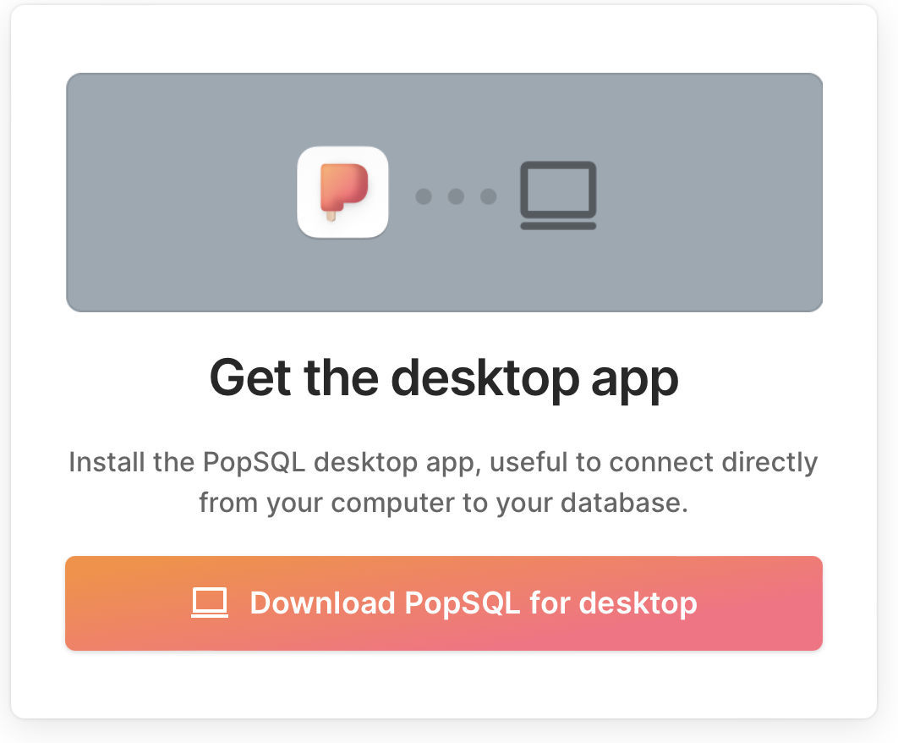
Pop SQL
The ease-of-use application which manages database using SQL commands to display the result
Easy to setup the database environment
Include export features to CSV or JSON format
Free versions can accept the maximum of draft file up to five files, and one setup database evironment
Require MySQL installation (Review Basic SQL Week 2 slide)

Slide 6
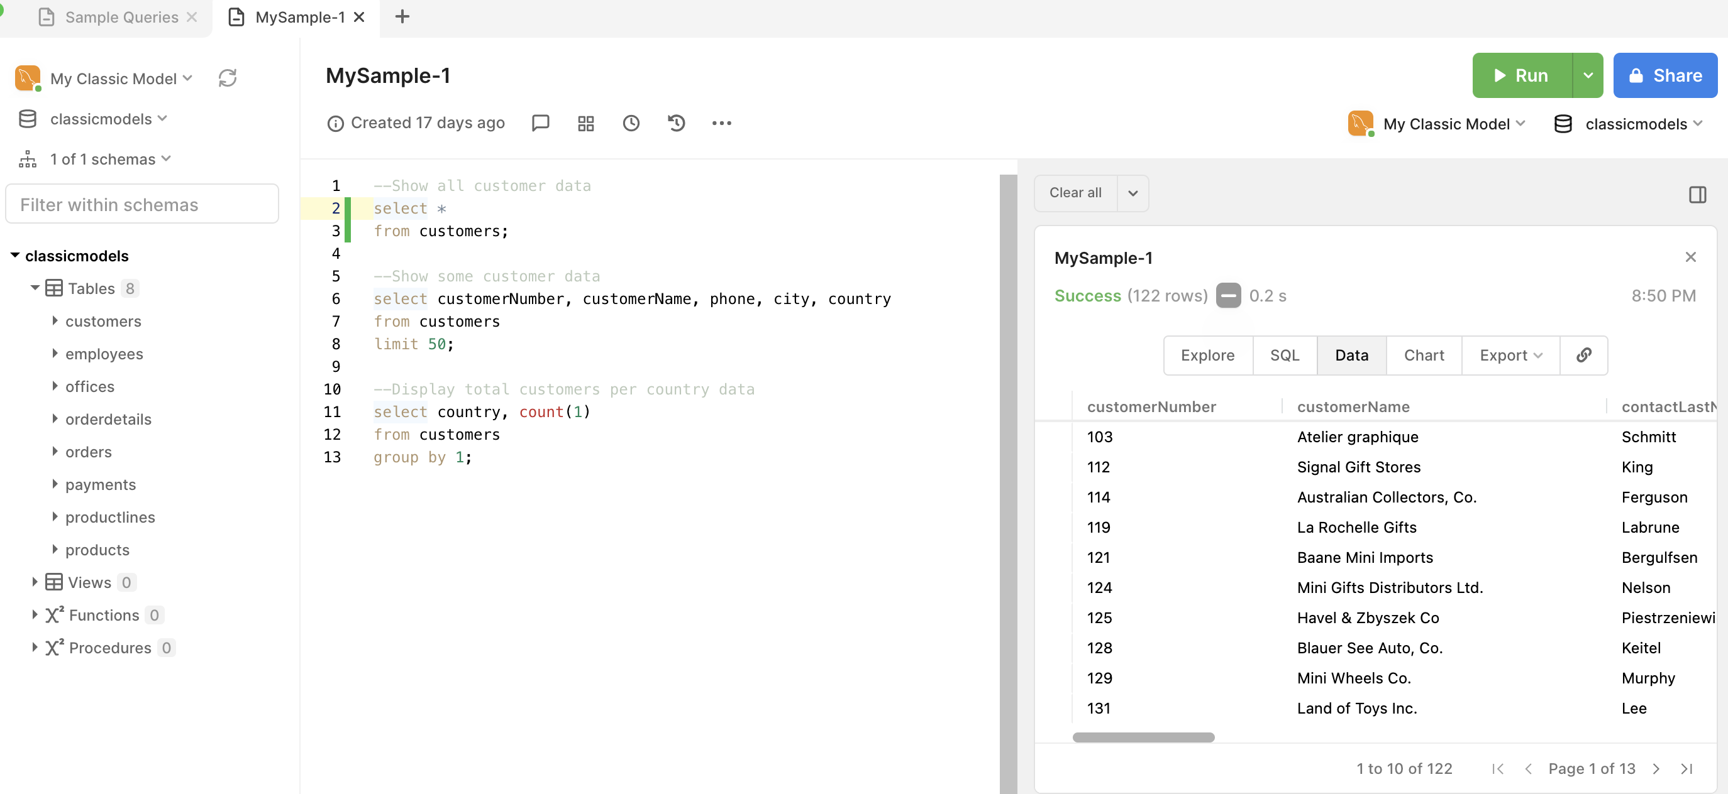
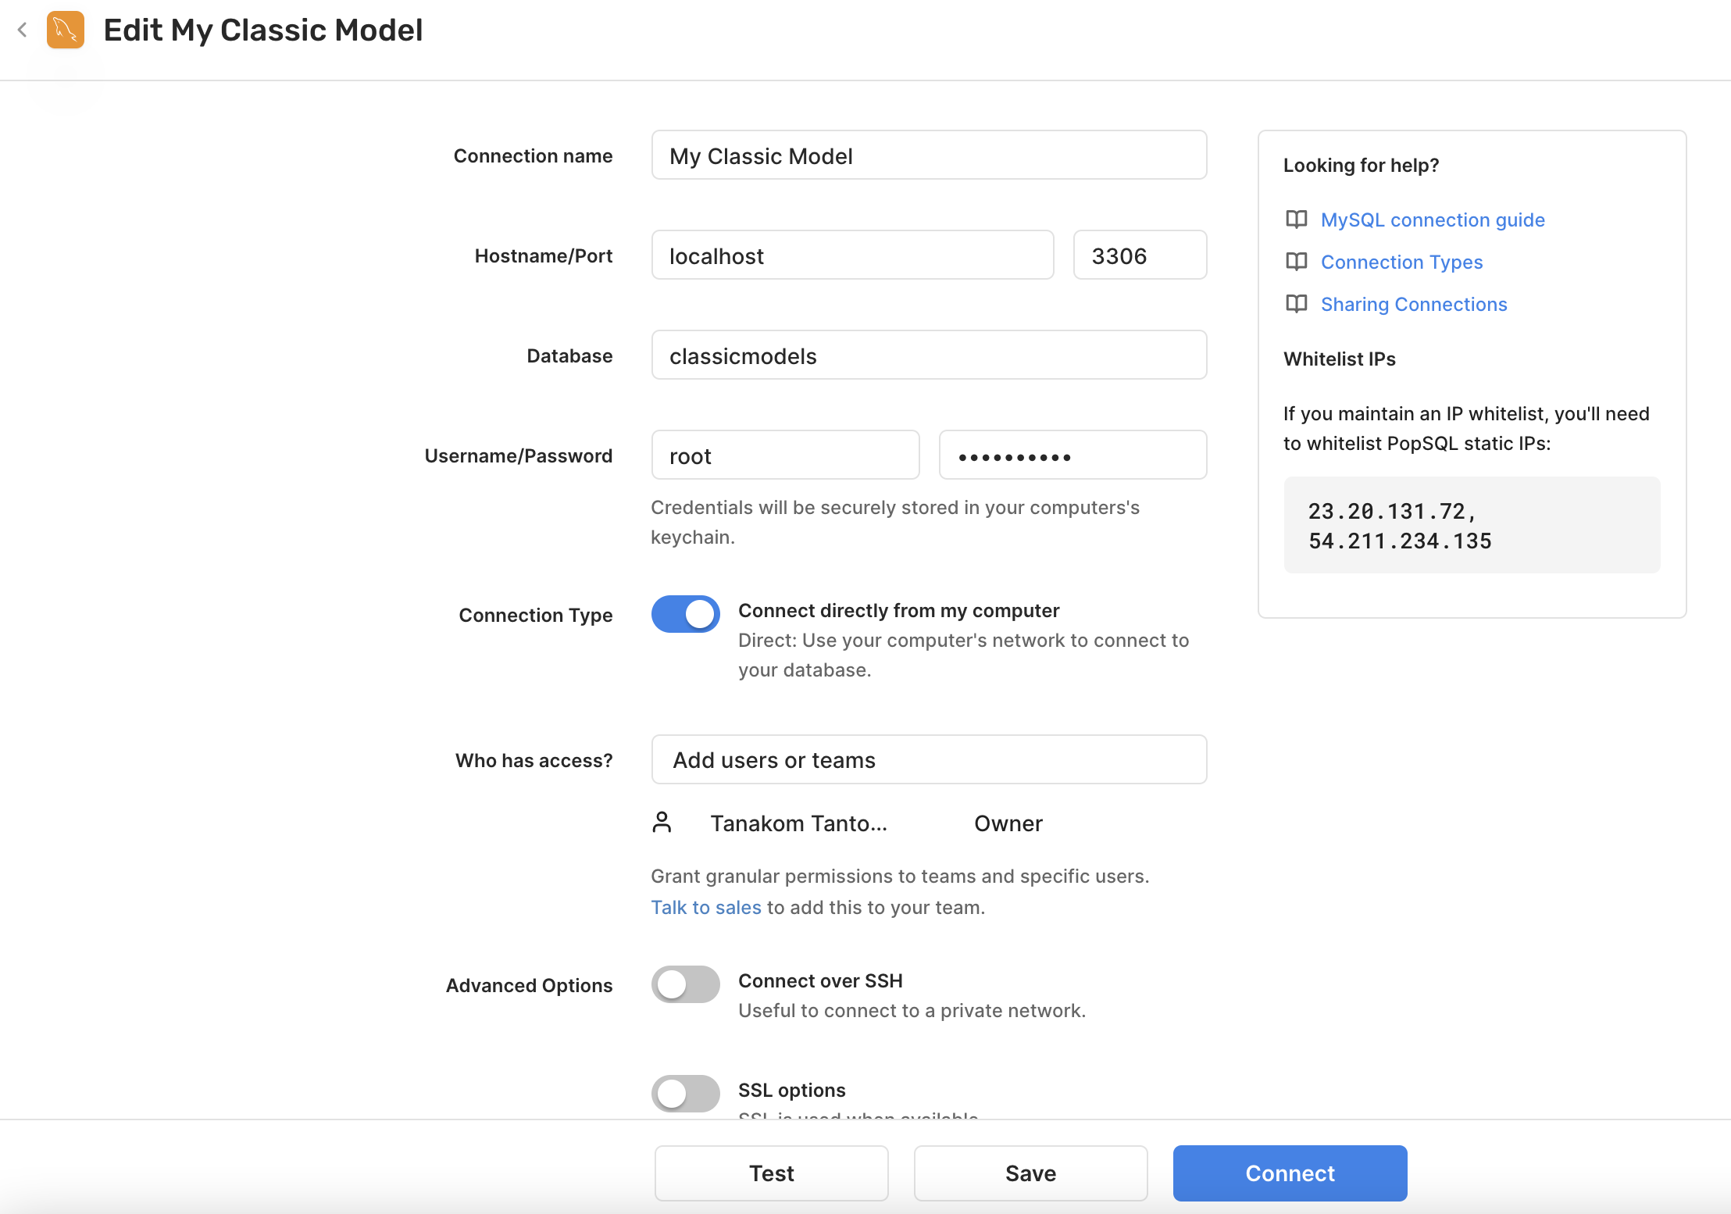
Pop SQL

Slide 7

DBM Tool for JSON
DBM Tool v.1.2.2 by Dr. Anan Osothslip
The tool that introduces how data can be constructed and converted into the SQL and database tables
The input can be JSON only that process the output into SQL and database tables
This tool also provides catalog, departments, roles, positions, users, processes, and assets in order to identify what kind of these data to support your business
The Internet connection is also required for this tool (Review Data Model Diagram Week 6 Slide)

Slide 8
DBM Tool for JSON
JSON structure explains …
Stands for JavaScript Object Notation
It is a text format for storing and transporting data
It is a “self-describing” and easy to understand
The example looks like this:
{
“name”: “John”,
“age”: 30,
“car”: “Toyota”
}
It identifies with 3 properties:
name = John (text)
age = 30 (integer)
car = Toyota (text)
*Each property has a value
“Mr. John with age of 30 years old has got a Toyota car.”

Slide 9
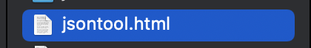
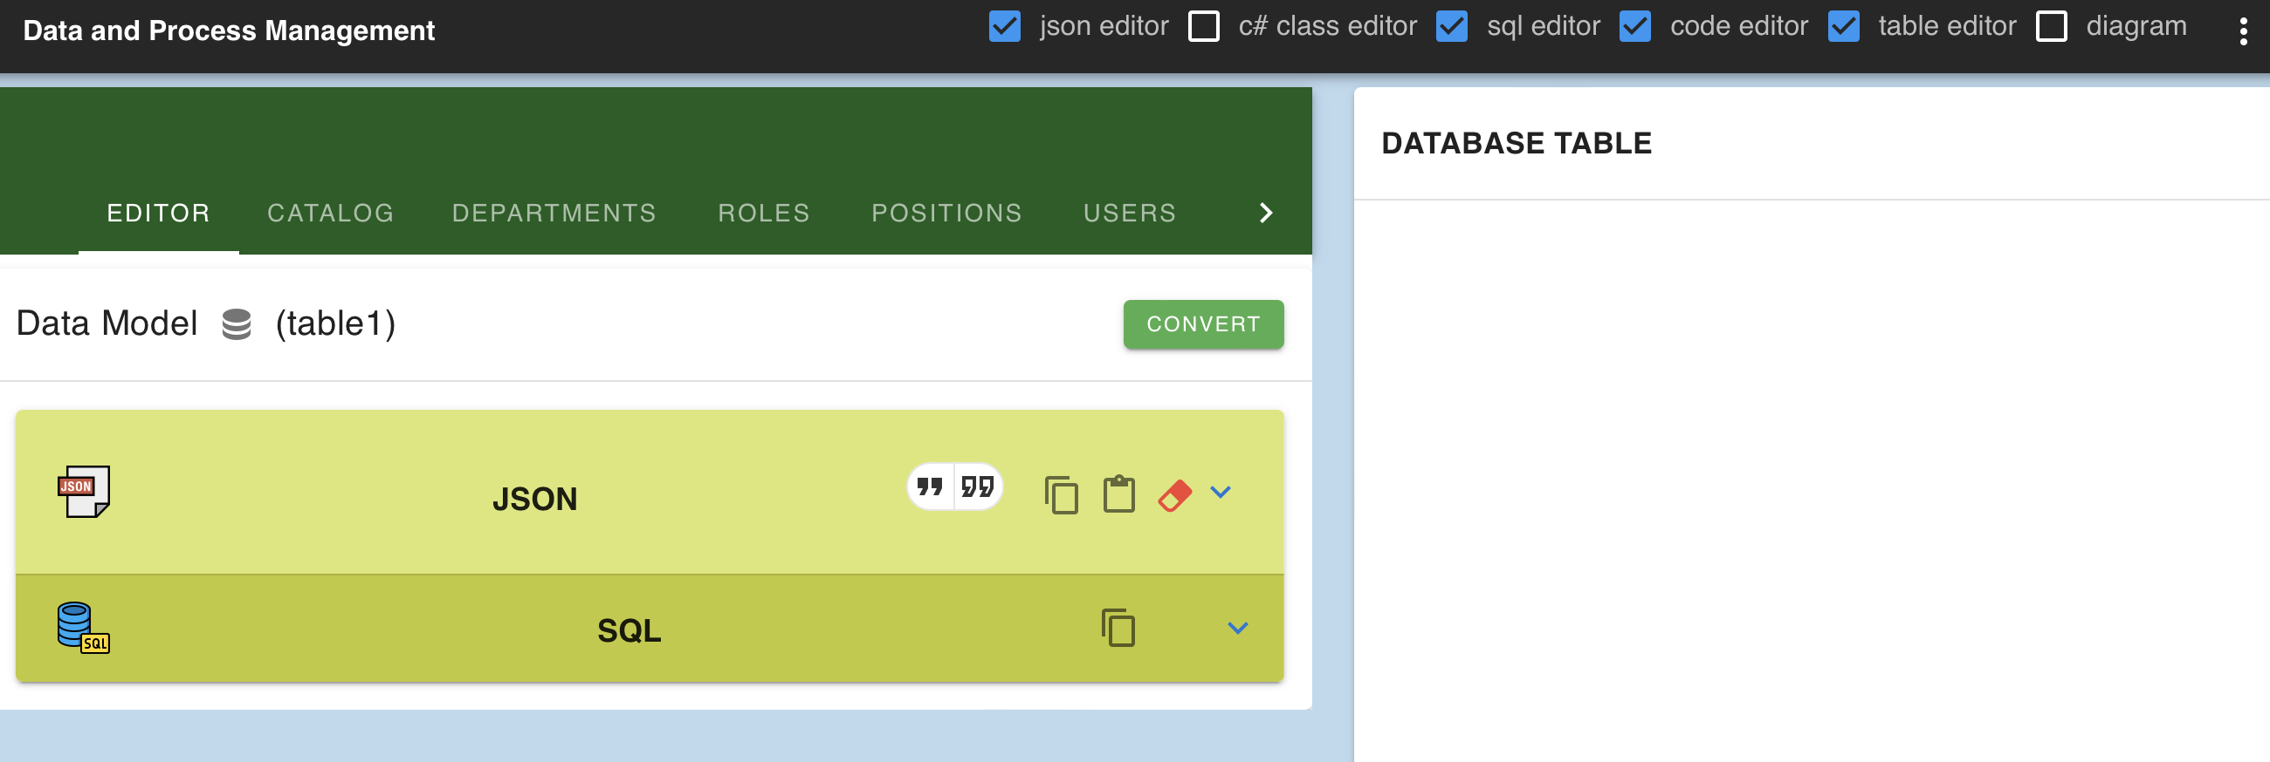
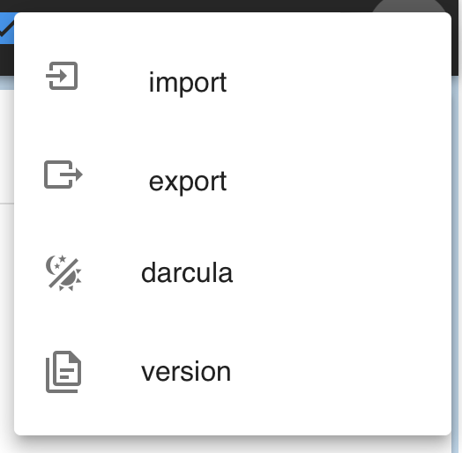
DBM Tool for JSON
Please uncheck this check box first!
Double click to open
Import/Export file
Menu Selection
Data Model Name
Convert button
JSON Input Area
SQL Output Area
Database Table Output Area

Slide 10
Python
Python is a high-level programming language developed by Guido Van Rossum
It is an interpreted language and supports multiple programming paradigms such as imperative, functional, and object-oriented
Python has a design philosophy that emphasizes code readability, and this makes it the most favorite programming language for beginners
Data management can be a challenging task for beginners because it requires sophisticated and complex knowledge
However, with python, you can automate data management processes and manage your data more efficiently
Python is a 100% pure scripting language that not quite a low code but can be less code for beginners to development more
Example: Pandas Profiling

Slide 11
Python

Slide 12
Node-RED
An open-source low code tool, for connecting hardware devices, APIs and online services creatively and easily.
Primarily, it is a visual tool designed for the Internet of Things, but can also be used for other applications to very quickly assemble flows of various services
Node-RED provides a browser-based flow editor that makes it easy to wire together flows using the wide range of nodes in the palette. Flows can be then deployed to the runtime in a single-click

Slide 13
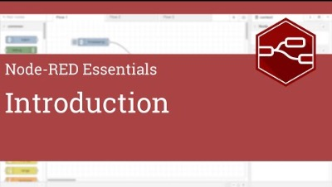
Node-RED
Soure for this video: https://youtu.be/ksGeUD26Mw0

Slide 14
Web Service Integration using RFM Analysis

Slide 15
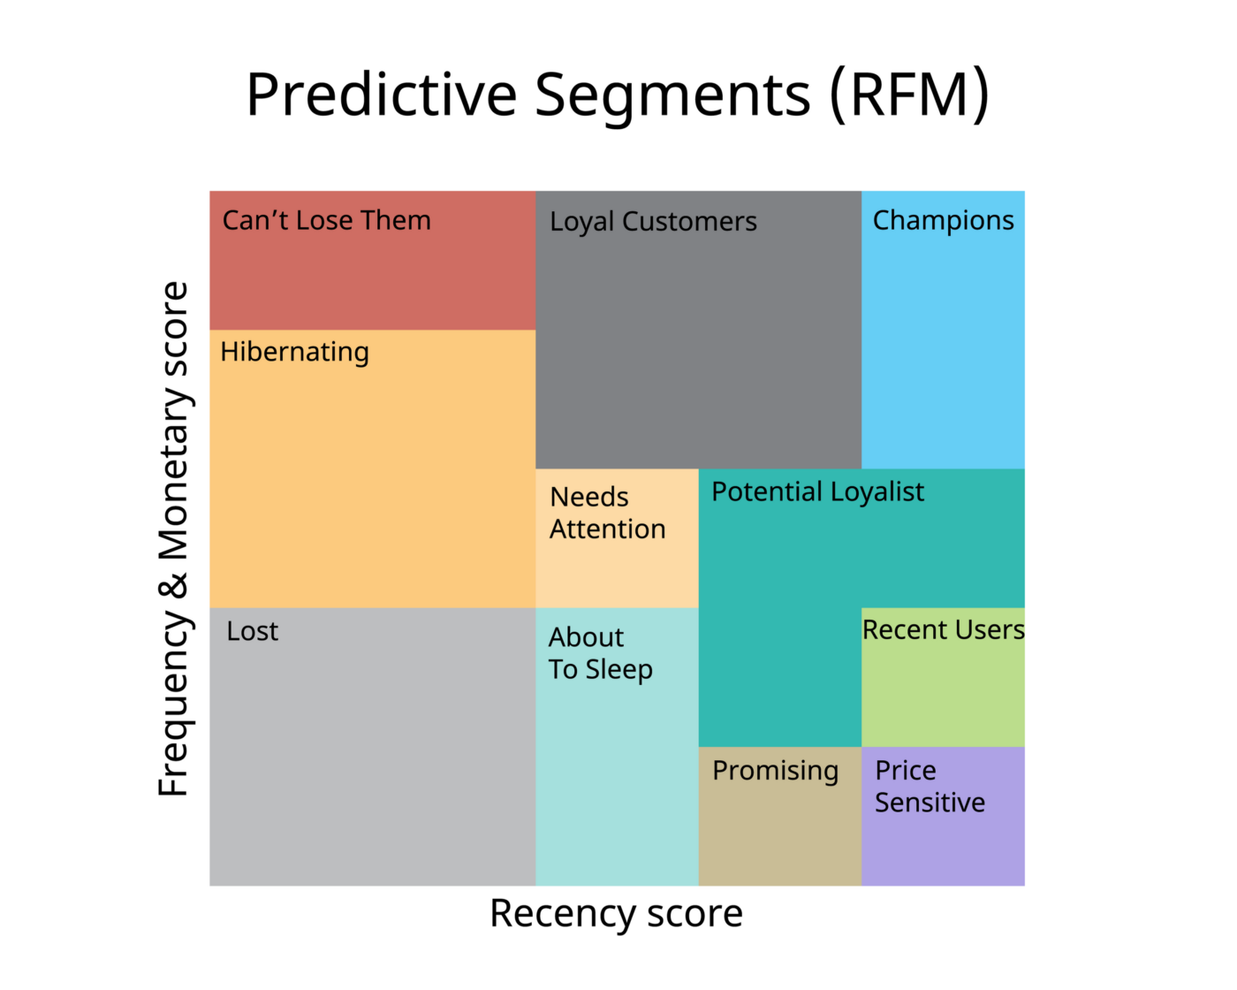
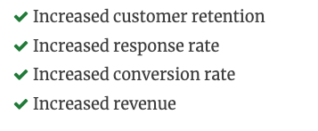
Data Management> What is RFM Analysis?
A classification technique to help segment customers into a group of customer segmentation
Use Big Sale Data (customer info, order detail, and date time )
Based on Sale User Story
Goals

Slide 16




Data Management> RFM Method
customer1
customer2
customer3
monetary
1000$
500$
100$
frequency
recency
2 years ago
Last 12 months
10 days

Slide 17
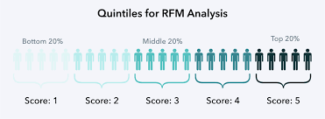
Data Management> RFM Method (cont)
customer1
customer2
customer3
Quartile ranking
monetary
5
3
1
1000
500
100
frequency
1
5
1
1
4
1
recency
1
3
5
650 days
365 days
10 days
rfm score
115
353
511

Slide 18
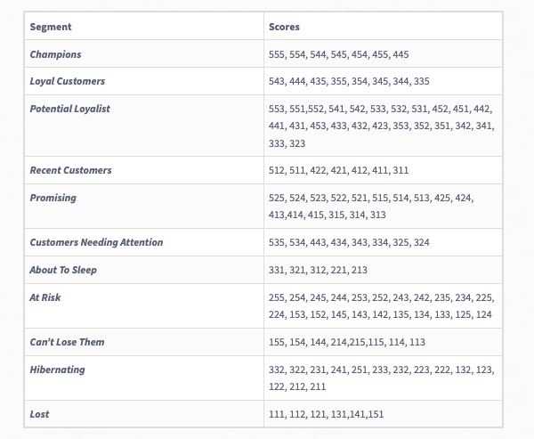
Data Management> RFM Score Matching

Slide 19

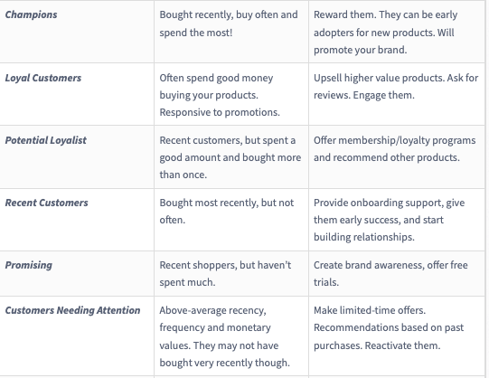
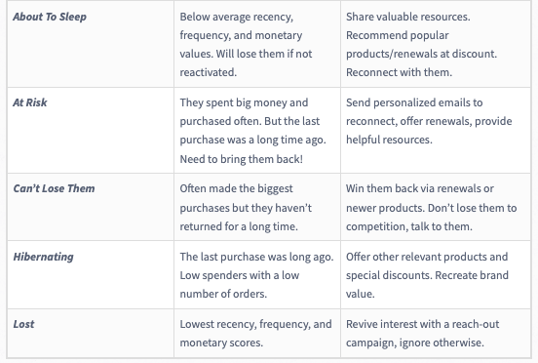
Data Management> RFM Marketing action per segmentation

Slide 20
Data Management> RMF and Sale analytic with #purchases
1: purchase (the majority)
2 : purchases (those who had overcome the psychological barrier and came again, knowing how the store works)
3-4 : purchases (in spite of everything, they continue to buy, so it is necessary to keep them at any costs)
5-15 : purchases (believed us, they are our main hope. The upper limit here can be very different)
more than 15 purchases : (freaks, often resellers, partners, etc. They need to be reviewed separately)

Slide 21
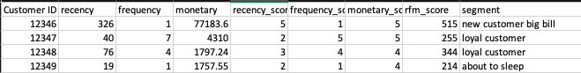
Data Management> Data Management workflow for RFM analytic
Big Sale Data
~ 550,000
Customer Segmentation Data
csv
Data Manipulation
df
RFM Analysis
df
To csv
Drop null row
Remove invoice with cancel status
Calculate Total for each transactions
Generate recency raw score
Generate frequency raw score
Generate Total raw score
Country sale
Segment count
Customer by segment
Generate RFM Score by raw score using quartile ranking
Via pd.qcut
Segment matching with regex

